Slide 1
QSGD: Communication-Efficient SGD via Gradient Quantization and Encoding
NeurIPS 2017

Slide 2
The Practical Problem
Training Large machine learning models efficiently
Large Datasets
ImageNet: 1.6 million images(~300GB)
NIST2000 Switchboard dataset: 2000 hours
Large Models
ResNet-152: 152 layers, 60 million parameters
LACEA: 22 layers, 65 million parameters

Slide 3
Data-Parallel Stochastic Gradient Descent

Slide 4
Data-Parallel SGD(Bigger Model)

Slide 5
Data-Parallel SGD(Biggerer Model)

Slide 6
Idea: compress the gradients…

Slide 7
Background on vanilla SGD
Let $f:ℝ^{n}→ℝ$ be a function which we want to minimize
Access stochastic gradients $\tilde{g}$ such that $𝔼\left[\tilde{g}\left(x\right)\right]=f(x)$
Update rule $x_{t+1}=x_{t}−η_{t}\tilde{g}\left(x\right)$
$T=O(R^{2}·max⁡(\frac{2σ^{2}}{ε^{2}},\frac{L}{ε}))$

Slide 8
Mini-Batch SGD
Update form $x_{t+1}=\prod_{𝒳}{(x_{t}−η_{t}{\tilde{G}}_{t}\left(x_{t}\right))}$, where ${\tilde{G}}_{t}\left(x_{t}\right)=\frac{1}{m}\sum_{i=1}^{m}{{\tilde{g}}_{t,i}}$
Each ${\tilde{g}}_{t,i}$ is an independent stochastic gradient for $f$ at $x$
If ${\tilde{g}}_{t,i}$ are stochastic gradients with variance bound $σ^{2}$, then ${\tilde{G}}_{t}$ is a stochastic gradient with variance bound $\frac{σ^{2}}{m}$
Mini-Batch SGD requires $\frac{1}{m}$ fewer iterations to convergen

Slide 9
Data-Parallel SGD
Support we have $K$ processers
Update form $x_{t+1}=x_{t}−(η_{t}/K)\sum_{ℓ=1}^{K}{{\tilde{g}}^{ℓ}(x_{t})})$,
Each ${\tilde{g}}_{t,i}$ is an independent stochastic gradient for $f$ at $x$

Slide 10
Quantized SGD(QSGD)
$log⁡$ denotes the base-2 logarithm
The number of bits to represent a float is 32
For any vector $v∈ℝ^{n}$, let ${\left\|v\right\|}_{0}$ denote the number of nonzeros of $v$.
For any string $ω∈\{0, 1\}$, let $|ω|$ denote its length
For any scalar $x∈ℝ$, let $sgn⁡(x)∈\{−1, +1\}$ denote its sign, with $sgn⁡(0)=1$.

Slide 11
Stochastic Quantization
Quantization function
$$Q\left(v_{i}\right)={\left\|v\right\|}_{2}·sng\left(v_{i}\right)·ξ_{i}(v_{i})$$
Where $ξ_{i}\left(v_{i}\right)=1$ with probability $\left|v_{i}\right|/{\left\|v\right\|}_{2}$ and 0, otherwise
Properties:
1. Unbiasedness:
$$𝔼\left[Q\left[v_{i}\right]\right]={\left\|v\right\|}_{2}·sgn\left(v_{i}\right)\frac{\left|v_{i}\right|}{{\left\|v\right\|}_{2}}=v_{i}$$
2. Second moment (variance) bound:
$$𝔼\left[{\left\|Q\left[v\right]\right\|}^{2}\right]≤\sqrt{n}{\left\|v\right\|}^{2}$$
$$𝔼\left[{\left\|Q\left[v\right]−v\right\|}^{2}\right]≤min⁡(\frac{n}{s^{2}},\frac{\sqrt{n}}{s}){\left\|v\right\|}^{2}$$
3. Sparsity: If $v$ has dimension n, then
$$𝔼\left[{\left\|Q\left[v\right]\right\|}_{0}\right]=𝔼\left[\sum_{i}{ξ_{i}\left(v\right)}\right]≤\frac{{\left\|v\right\|}_{1}}{{\left\|v\right\|}_{2}}≤\sqrt{n}$$

Slide 12
Efficient Coding of Gradients
Encode(5) = 10 101 0
Encode(9) = 11 1001 0
To code a number N:
Place a "0" at the end of the code
If N = 1, stop; encoding is complete
Prepend the binary representation of N to the beginning of the code. This will be at least two bits, the first bit of which is a 1
(4) Let N equal the number of bits just prepended, minus one
(5) Return to step 2 to prepend the encoding of the new N

Slide 13
Efficient Coding of Gradients
To decode an Elias omega-coded integer:
Start with a variable N, set to a value of 1
If the next bit is a "0", stop. The decoded number is N
If the next bit is a "1", then read it plus N more bits, and use that binary number as the new value of N. Go back to step 2.
Decode(10 101 0) = 2, 5
Decode(11 1001 0) = 3, 9

Slide 14
Efficient Coding of Gradients
Given a gradient vector represented $({\left\|v\right\|}_{2},σ, ζ)$, with $s$ quantization levels
First, use 32 bits to encode ${\left\|v\right\|}_{2}$
Use Elias coding the position of the first nonzero entry of $ζ$, then appends a bit denoting $σ_{i}$ and follows that with $Elias(s·ξ_{i}(v, s))$
Iteratively, it proceeds to encode the distance from the current coordinate of $ζ$ to the next nonzero, and encodes the $σ_{i}$ and $ζ_{i}$ for that coordinate in the same way

Slide 15
Efficient Coding of Gradients
First read off 32 bits to construct ${\left\|v\right\|}_{2}$
Then iteratively use the decoding scheme for Elias recursive coding to read off the positions and values of the nonzeros of $ζ$ and $σ$

Slide 16
Experimental Setup
Where?
Amazon p16xLarge(16x NVIDIA K80 GPUs), with NVIDIA DirectConnect
Microsoft CNTK v2.0, with fast MPI-based communication
What?
Task: image classification(ImageNet, CIFAR) and speech recognition(CMU AN4)
Nets: ResNet, VGG, AlexNet, respectively LSTM, with default parameters
Why?
Accuracy vs. Speed/Scalability
How long?
>25K GPU hours

Slide 17
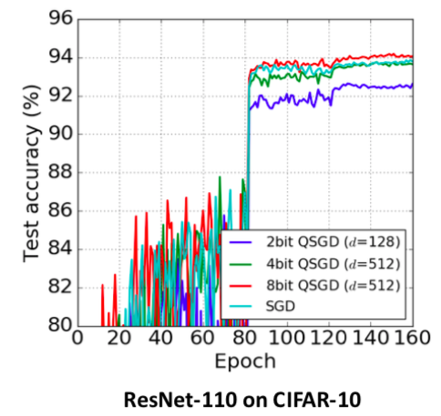
Experiments: Accuracy

Slide 18
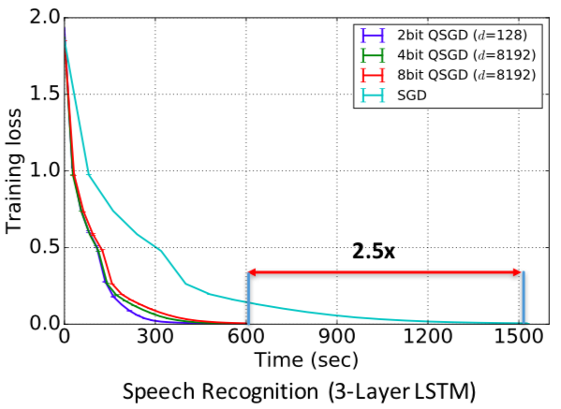
Accuracy vs Time on LSTM
AN4 dataset, 2x Titan X GPUs

Slide 19
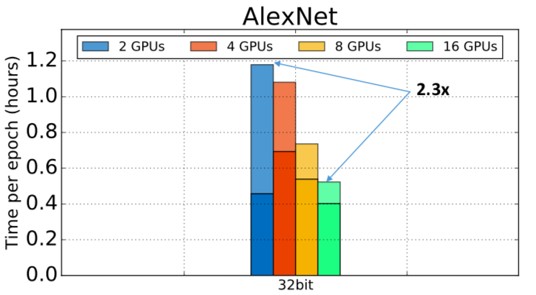
Experiments: Scalability
All experiments ran on ImageNet
Amazon baseline:

Slide 20
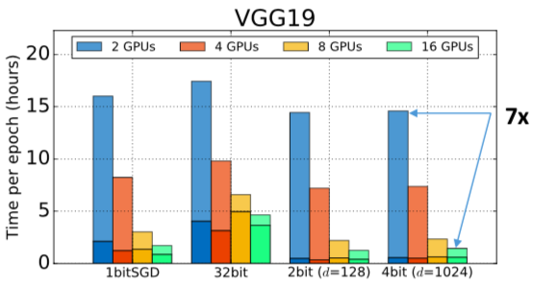
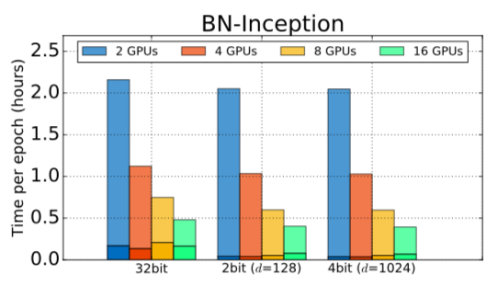
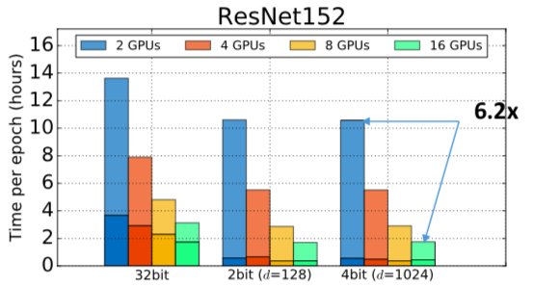
Experiments: Scalability

Slide 21
Summary
QSGD is a family of lossy compression schemes which trade off low bit complexity and convergence time
QSGD is theoretically optimal, can be practical, and extensible to end-to-end compression

Slide 22
Some Improvements…
GradiVeQ(NeurIPS2018)
Sparsified SGD with Memory(NeurIPS2018)
ECQ-SGD(ICML2018)
More and more…

Slide 23
Error Compensated Quantized SGD (ICML2018)
The core idea of ECQ-SGD is that when quantizing local gradients, both the current gradients and previously accumulated quantization error should be taken into consideration. Specifically, we use $h_{p}^{(t)}$ to denote the accumulated quantization error of the $p$-th node at the $t$-th iteration:
$$h_{p}^{(t)}=\sum_{t^{′}=0}^{t−1}{β^{t−1−t^{′}}(g_{p}^{\left(t^{′}\right)}−{\tilde{g}}_{p}^{(t^{′})})}$$

Slide 24
Thank you!

